Slide 1

Intro to AWS Cloud Development Kit
Elad Ben-Israel
Principal Software Engineer
Amazon Web Services
Notes:
Notes:
Provide an impactful intro or slogan.
Use analogies to back up the points that you’re making.
Start with a strong intro / vision
Add social proof / case studies

Slide 2



Floor28 Agenda
Big Data Day
14 Oct
ML & DL Day
15 Oct
DevOps Day
16 Oct
DevOps Day
17 Oct
Databases Day
18 Oct
Technical Sessions
Serverless Data Workshop
Big Data UG Meetup
Technical Sessions
SageMaker Workshop
ML&DL Meetup
Technical Sessions
K8s Workshop
DevOps Meetup
Technical Sessions
Spot Workshop
Technical Sessions
PyTorch Meetup
Builders Day Serverless backend
21 Oct
Builders Day
AppSync, Alexa & IoT
22 Oct
Enterprise IT Day
23 Oct
GameDay
24 Oct
Technical Sessions
Serverless Workshop
Virtual assistants UG Meetup
Technical Sessions
CDK Workshop
AWS IL UG Meetup
Technical Sessions

Slide 3
About me
Elad Ben-Israel Principal Software Engineer AWS Developer Tools & SDKs
Unexplainable desire to write code since I’m about 10
Unexplainable joy from creating tools and SDKs for developers
4 years with Amazon (London, San Francisco and now Tel-Aviv)
Prime Air, Amazon Product Search and now AWS SDKs and Tools
benisrae@amazon.com
Twitter: @emeshbi
GitHub: eladb
👋

Slide 4
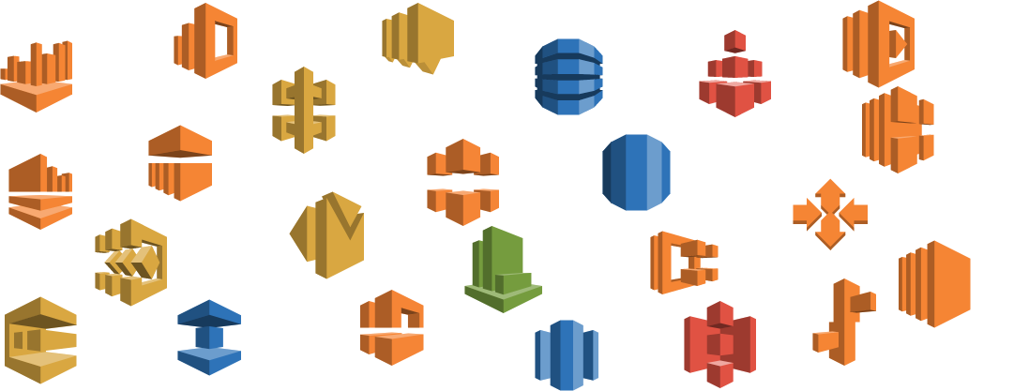
Modern cloud applications have lots of “bits”

Slide 5
Modern cloud applications have lots of “bits”…

Slide 6
Use the console?
Time consuming
Hard to audit
Error prone
Not reproducible
Manual

Slide 7
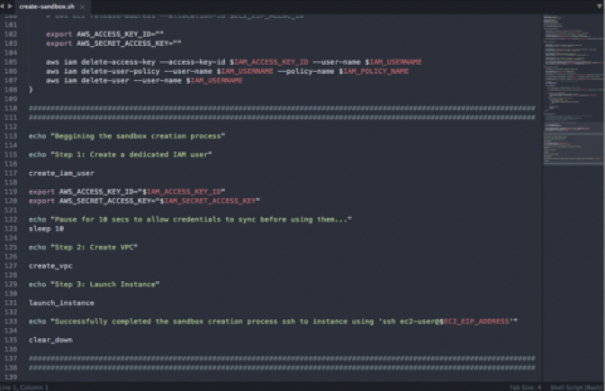
Write a script?
What happens if an API call fails?
How do I roll back?
How do I make updates?
How do I know a resource is ready?

Slide 8
Resource Provisioning Engines
Infrastructure as Code
Desired State Configuration
Create
Update
Delete
diff
CloudFormation Template
JSON/YAML
AWS
CloudFormation

Slide 9
YAML Developer
Certified
100% expert at indentation issues

Slide 10
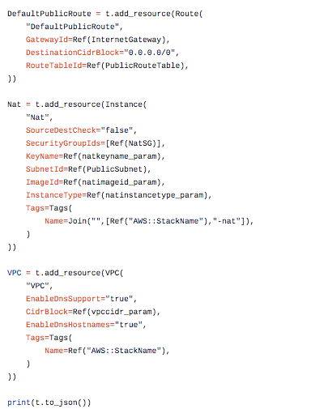
CloudFormation DOMs
Troposphere (Python)
SparkleFormation (Ruby)
CFN-DSL (Ruby)
goformation (Go)
REAL CODE ❤️ : “if” statements, for loops
Language-specific
Stay at the CloudFormation abstraction level

Slide 11
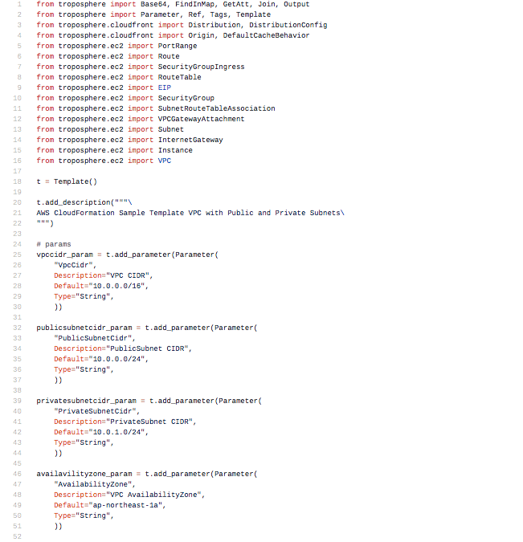
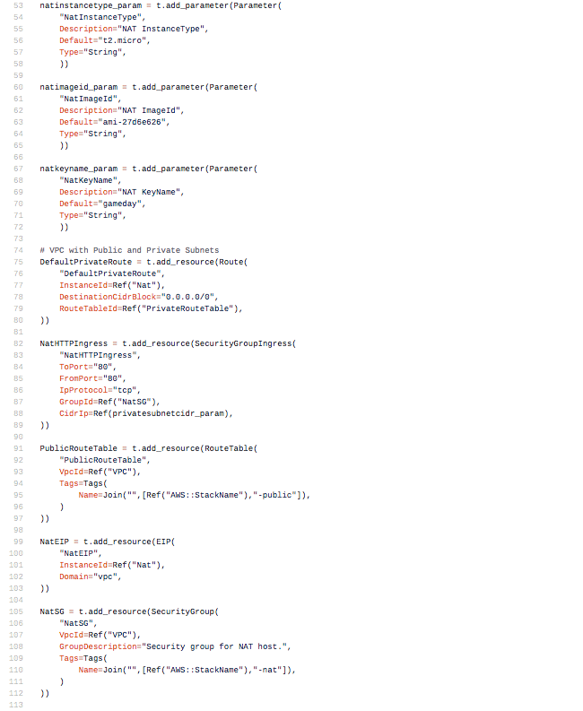
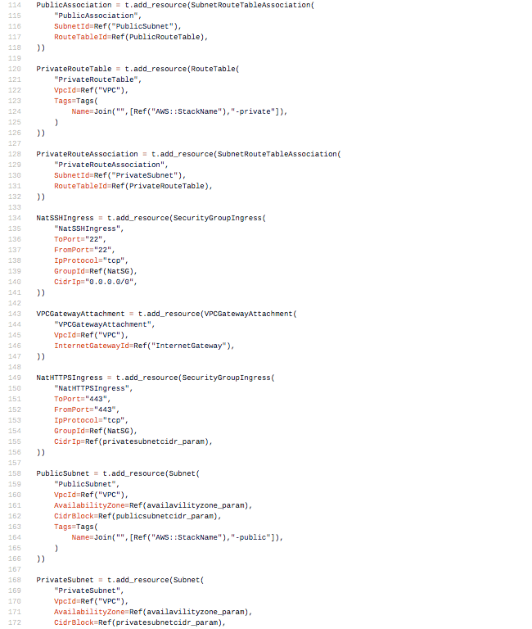
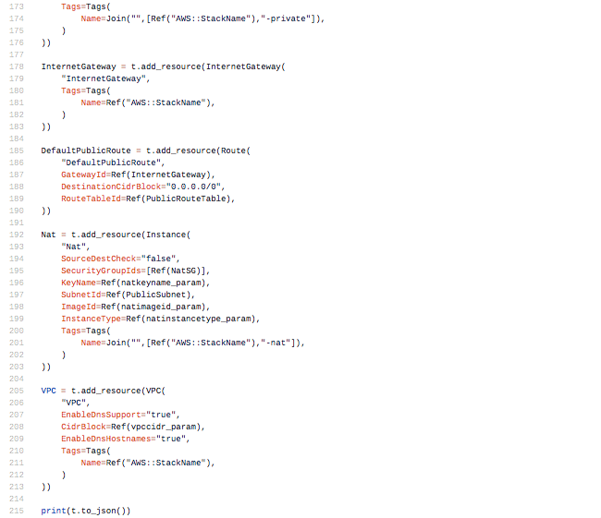
CloudFormation Abstraction Level?
Public/Private VPC
With Troposphere
218 lines of Python

Slide 12
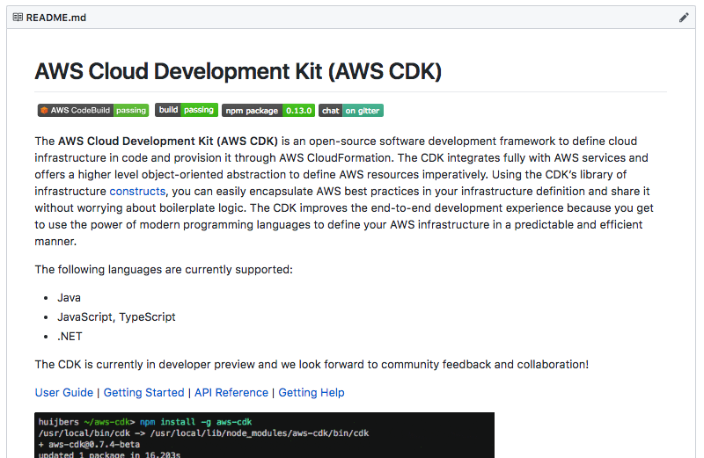
Introducing
AWS Cloud Development Kit

Slide 13
AWS Cloud Development Kit (CDK)
Real code ❤️ - naturally express infrastructure logic
Supports all familiar programming language, IDEs and and tools
Open source, developer preview
Come build it with us!
more…

Slide 14
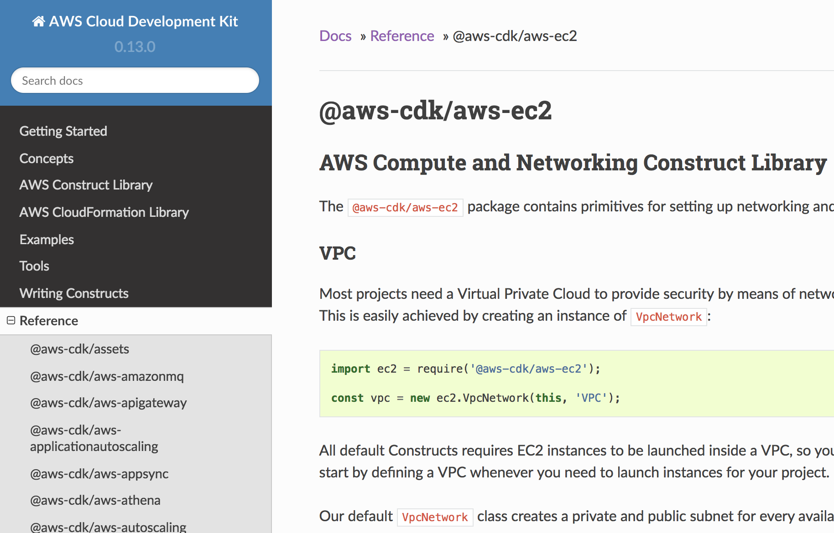
👍 👍 👍 Constructs
Abstract and reusable “cloud components”:
Encapsulates infra behind an object-oriented API
Bundles assets (runtime code, docker images, static files)
Composable
What can we do with constructs?
High-level class library for AWS – the AWS Construct Library
Modularize your app
Publish your own

Slide 15
Let’s take it for a spin!
https://cdkworkshop.com

Slide 16
In this workshop…
You’ll need:
Laptop
AWS account for experimentation
Basic coding skills
Chapters:
Setup your environment
Create a project
Hello, CDK! (APIGW + Lambda)
Write your own construct
Use a construct library
Get started at
https://cdkworkshop.com

Slide 17
benisrae@amazon.com
Twitter: @emeshbi

Slide 18
GAME DAY PUT YOUR SKILLS TO THE TEST OCT 24 Register now: bit.ly/Floor28GameDay

